Slide 1
CODE OPTIMIZATION

Slide 2
The code produced by the straight forward compiling algorithms can often be made to run faster or take less space, or both. This improvement is achieved by program transformations that are traditionally called optimizations.
Compilers that apply code-improving transformations are called optimizing compilers.
Optimizations are classified into two categories. They are
Machine independent optimizations:
Machine dependant optimizations:

Slide 3
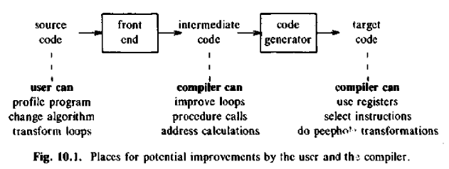

Slide 4
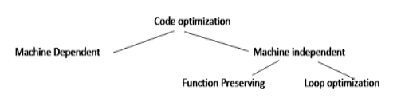
Machine independent optimizations:
Machine independent optimizations are program transformations that improve the target code without taking into consideration any properties of the target machine.
Machine dependant optimizations:
Machine dependant optimizations are based on register allocation and utilization of special machine- instruction sequences.

Slide 5
The criteria for code improvement transformations:
The transformation must preserve the meaning of programs. That is, the optimization must not change the output produced by a program for a given input, or cause an error such as division by zero, that was not present in the original source program.
A transformation must, on the average, speed up programs by a measurable amount.
The transformation must be worth the effort. It does not make sense for a compiler writer to expend the intellectual effort to implement a code improving transformation and to have the compiler expend the additional time compiling source programs if this effort is not repaid when the target programs are executed.

Slide 6
Flow analysis is a fundamental prerequisite for many important types of code improvement.
Generally control flow analysis precedes data flow analysis.
Control flow analysis (CFA) represents flow of control usually in form of graphs, CFA constructs such as
A transformation of a program is called local if it can be performed by looking only at the statements in a basic block; otherwise, it is called global.
Many transformations can be performed at both the local and global levels. Local transformations are usually performed first.

Slide 7
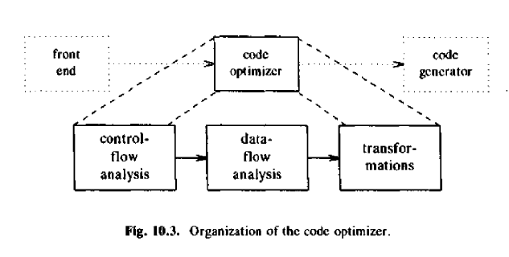

Slide 8
THE PRINCIPAL SOURCES OF OPTlMIZATION
Machine Independent Optimizations:
Function-Preserving Transformations:
Common sub-expression elimination
Copy-Propagation
Dead-Code Elimination
Compile-time Evaluation
Constant Propagation
Constant Folding
Loop Optimizations:
Code Motion
Induction Variable Elimination
Strength Reduction
Loop Fusion
Loop Unrolling

Slide 9
Common Sub-expression Evaluation
Identify common sub-expression present in different expression, compute once, and use the result in all the places.
The definition of the variables involved should not change
Example:
a := b * c temp := b * c
… a := temp
… …
x := b * c + 5 x := temp + 5

Slide 10
t1 = a + b
c = t1
t2 = m * n
d = t2
t3 = b + d
e = t3
f = t1
g = -b
h = t1 /* commutative */
a = j + a
k = t2
j = t3
a = -b
if t2 go to L
c = a + b
d = m * n
e = b + d
f = a + b
g = - b
h = b + a
a = j + a
k = m * n
j = b + d
a = - b
if m * n go to L

Slide 11
Copy Propagation
f := g are called copy statements or copies
Use of g for f, whenever possible after copy statement
Example:
x[i] = a; x[i] = a;
sum = x[i] + a; sum = a + a;
May not appear to be code improvement, but opens up scope for other optimizations.

Slide 12
Dead Code Elimination
A variable is live at a pint in a program if its value can be used subsequently; otherwise, it is dead at that point. A related idea is dead or useless code, statements that compute values that never get used.
Examples:
DEBUG:=0
if (DEBUG) print Can be
eliminated

Slide 13
Compile-Time Evaluation
Constant folding
Evaluation of an expression with constant operands to replace the expression with single value
Example:
area := (22.0/7.0) * r ** 2
area := 3.14286 * r ** 2

Slide 14
Compile-Time Evaluation
Constant Propagation: Replace a variable with constant which has been assigned to it earlier.
Example:
pi := 3.14286
area = pi * r ** 2
area = 3.14286 * r ** 2

Slide 15
Code Motion
Reduce the evaluation frequency of expression.
Bring loop invariant statements out of the loop.
a = 200; while(a>0) { b = x + y; if (a % b == 0} printf(“%d”, a); } //This code can be further optimized as a = 200; b = x + y; while(a>0) { if (a % b == 0} printf(“%d”, a); }

Slide 16
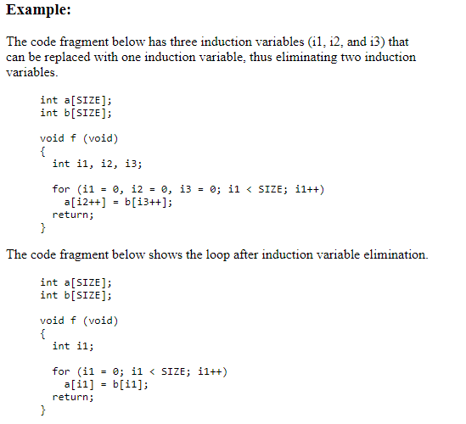
Induction Variable Elimination:

Slide 17
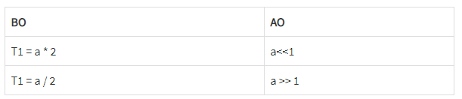
Strength Reduction
In this technique,
As the name suggests, it involves reducing the strength of expressions.
This technique replaces the expensive and costly operators with the simple and cheaper ones.
Example-
Here,
The expression “A x 2” is replaced with the expression “A + A”.
This is because the cost of multiplication operator is higher than that of addition operator.
Code Before Optimization | Code After Optimization
B = A x 2 | B = A + A
The multiplication operator can be easily replaced by left shift operator a<<1 Division can be replaced by a a>>1 operator.

Slide 18
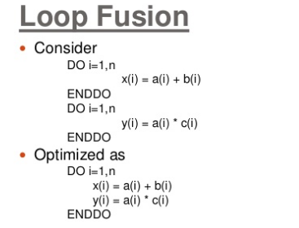
CPU can perform some operations in parallel.

Slide 19
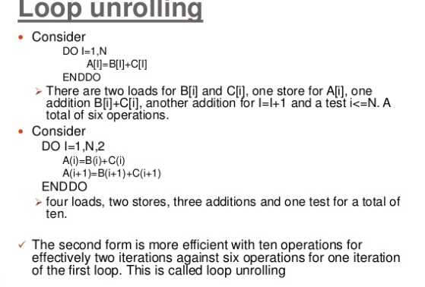

Slide 20
BASIC BLOCKS AND FLOW GRAPHS
Basic Block:
A basic block is a sequence of consecutive statements in which flow of control enters at the beginning and leaves at the end without halt or possibility of branching except at the end.
Partitioning a sequence of three address statements into basic blocks:
1. We first determine the set of leaders, the first statements of basic blocks.
The rules we use are the following.
i) The first statement is a leader.
ii) Any statement that is the target of a conditional or unconditional goto is a leader.
iii) Any statement that immediately follows goto or conditional goto statement is a leader.
2. For each leader, its basic block consists of the leader and all statements up to but not including the next leader or the end of the program.

Slide 21
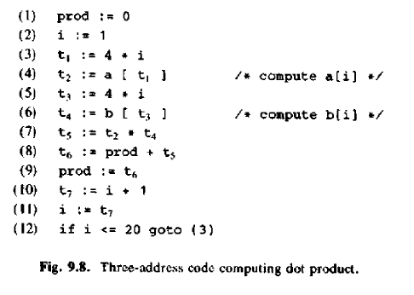
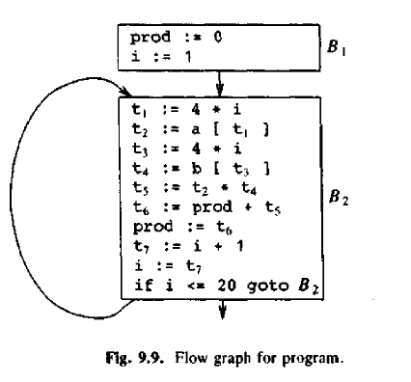

Slide 22
Flow Graphs
In the code optimizer, programs are represented by flow graphs, in which edges indicate the flow of control and nodes represent basic blocks.
One node is distinguished as initial; it is the block whose leader is the first statement. There is a directed edge from block B1 to block B2 if B2 can immediately follow B1 in some execution sequence; that is, if
I. there is a conditional or unconditional jump from the last statement of B1 to the first statement of B2, or
2. B2 immediately follows B1 in the order of the program, and B1 does not end in an unconditional jump.
We say that
B1 is a predecessor of B2
or
B2 is a successor of B1.

Slide 23
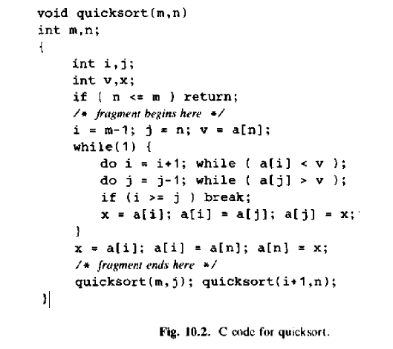

Slide 24
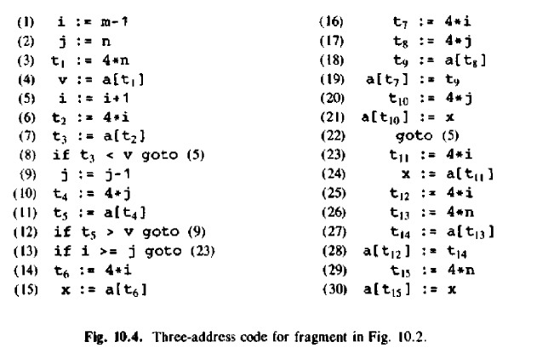

Slide 25
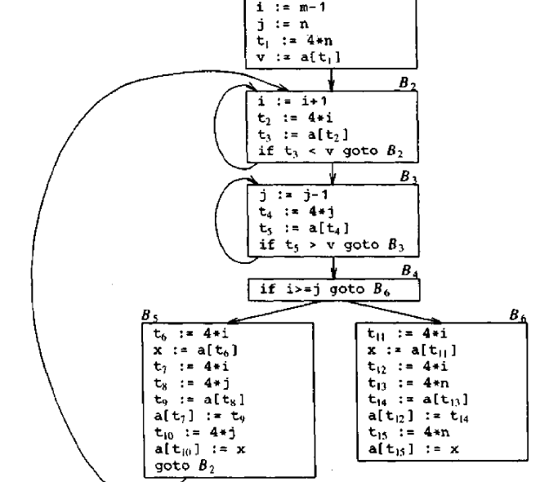

Slide 26
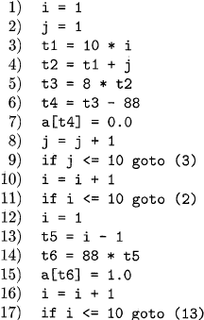
Intermediate code to set a 10*10 matrix to an identity matrix

Slide 27
Flow graph based on Basic Blocks

Slide 28
Transformations on Basic Blocks or Basic Block Optimizations:
There arc two important classes of local transformations that can be applied to basic blocks:
structure preserving transformations
algebraic transformations.
Structure-Preserving Transformations:
The primary structure-preserving transformations on basic blocks are:
I. common sub expression elimination
2. dead-code elimination
3. renaming of temporary variables
4. interchange of two independent adjacent statements

Slide 29
Common Sub Expression Elimination:
Identify common sub-expression present in different expression, compute once, and use the result in all the places.
The definition of the variables involved should not change
Example:
a := b * c temp := b * c
… a := temp
… …
x := b * c + 5 x := temp + 5
Dead Code Elimination:
Suppose x is dead, that is, never subsequently used, at the
point where the statement x : = y + z appears in a basic
block. Then this statement may be safely removed without
changing the value of the basic block.

Slide 30
Renaming temporary variables:
Suppose we have a statement t : = b+c, where t is a temporary. If we change this statement to u : = b+c, where u is a new temporary variable, and change all uses of this Instance of t to u, then the value of the basic block is not changed.
Interchange of statements:
Suppose we have a block with the two adjacent statements
t1 = b + c
t2 = x + y
Then we can interchange the two statements without affecting the value of the block if and only if neither x nor y is t1 and neither b nor c is t2.

Slide 31
Algebraic Transformations:
algebraic transformations can be used to change the set of expressions computed by a basic block into an algebraically equivalent set.
For example, statements such as
x = x + 0 or x = x * 1
can be eliminated from a basic block without changing the set of expressions it computes.
The exponentiation operator in the statement
x = y ** 2
usually requires a function call to implement. Using an algebraic transformation, this statement can be replaced by the cheaper, but equivalent statement
x = y * y

Slide 32
THE DAG REPRESENTATION OF BASIC BLOCKS
Directed acyclic graphs (dags) are useful data structures for implementing transformations on basic blocks. A dag gives a picture of how the value computed by each statement in a basic block is used in subsequent statements of the block.
A dag for a basic block is a directed acyclic graph with the following labels on nodes:
1. Leaves are labeled by unique identifiers, either variable names or constants.
2. Interior nodes are labeled by an operator symbol.
3. Nodes are also optionally given a sequence of identifiers for labels. The intention is that interior nodes represent computed values, and the identifiers labeling a node are deemed to have that value.

Slide 33
DAG Construction:
Suppose the current three-address statement is x := y op z
if node y is undefined, create a leaf labeled y,
and if node z is undefined, create a leaf labeled z,
and if op is undefined create a node for op whose left child is y and right child is z.
if another node p has the same value y op z then instead of adding a new node for P, existing node x can be labeled as p
Example:
x=y+z
p=y+z
+
X , P
y
z

Slide 34
Suppose the current three-address statement is x := op y,
create a node labeled op whose lone child is y.
Example :
x = -y
x
-
y
Suppose the current three-address statement is x := y,
do not create a node for x, instead, append x to the list of nodes for current value of y.
y
x

Slide 35
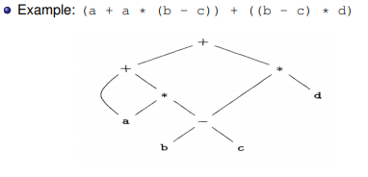
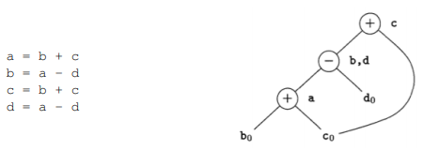

Slide 36

DAG for basic block

Slide 37
array accesses in a DAG
An assignment from an array, like x = a [i], is represented by creating a node with operator =[] and two children representing the initial value of the array, a0 in this case, and the index i. Variable x becomes a label of this new node.
An assignment to an array, like a [j] = y, is represented by a new node with operator []= and three children representing a0, j and y. There is no variable labeling this node. What is different is that the creation of this node kills all currently constructed nodes whose value depends on a0. A node that has been killed cannot receive any more labels; that is, it cannot become a common subexpression.

Slide 38
DAG for a sequence of array assignments

Slide 39
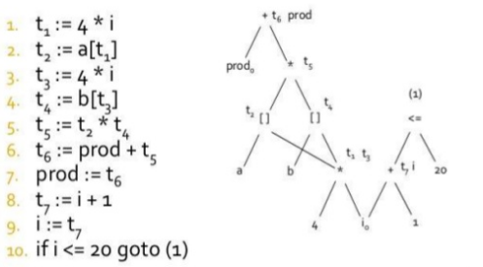

Slide 40
Data flow analysis :
It is the analysis of flow of data in control flow graph, i.e., the analysis that determines the information regarding the definition and use of data in program. With the help of this analysis optimization can be done. In general, it is the process in which values are computed using data flow analysis. The data flow property represents information which can be used for optimization.
Basic Terminologies –
Definition Point: a point in a program containing some definition.
Reference Point: a point in a program containing a reference to a data item.
Evaluation Point: a point in a program containing evaluation of expression.

Slide 42
Reaching Definition – A definition D is reaches a point p if there is path from D to p in which D is not killed, i.e., not redefined.

Slide 43
Available Expression – An expression is said to be available at a program point x iff along paths its reaching to x, expression is available at its evaluation point. A expression a+b is said to be available if none of the operands gets modified before their use.

Slide 44
Reaching vs Available Definitions
1: r1 = r2 + r3
2: r6 = r4 – r5
1,2 reach
1,2 available
1,2 reach
1,2 available
3: r4 = 4
4: r6 = 8
1,3,4 reach
1,3,4 available
5: r6 = r2 + r3
6: r7 = r4 – r5
1,2,3,4 reach

Slide 45
Live variable – A variable is said to be live at some point p if from p to end the variable is used before it is redefined else it becomes dead.

Slide 46
Example: Liveness
r2, r3, r4, r5 are all live as they
are consumed later, r6 is dead
as it is redefined later
r1 = r2 + r3
r6 = r4 – r5
r4 is dead, as it is redefined.
So is r6. r2, r3, r5 are live
r4 = 4
r6 = 8
r6 = r2 + r3
r7 = r4 – r5

Slide 47
A Use-Definition Chain (UD Chain) is a data structure that consists of a use, U, of a variable, and all the definitions, D, of that variable that can reach that use without any other intervening definitions. A definition can have many forms, but is generally taken to mean the assignment of some value to a variable .
A Definition-Use Chain (DU Chain), is a counterpart of UD chain, which consists of a definition, D, of a variable and all the uses, U, reachable from that definition without any other intervening definitions

Slide 48
Example: DU/UD Chains
1: r1 = MEM[r2+0]
2: r2 = r2 + 1
3: r3 = r1 * r4
DU Chain of r1:
(1) -> 3,4
(4) ->5
DU Chain of r3:
(3) -> 11
(5) -> 11
(12) ->
4: r1 = r1 + 5
5: r3 = r5 – r1
6: r7 = r3 * 2
7: r7 = r6
8: r2 = 0
9: r7 = r7 + 1
UD Chain of r1:
(12) -> 11
UD Chain of r7:
(10) -> 6,9
10: r8 = r7 + 5
11: r1 = r3 – r8
12: r3 = r1 * 2

